Slide 1
kNN (k Nearest Neighbour)

Slide 2
Umur di Pohon (Bulan) | Berat (Gram) | Jumlah Buah Dalam 1 Pohon | Buah Bagus?
15 | 10 | 5 | Bagus
9 | 11 | 12 | Bagus
10 | 5 | 5 | Tidak Bagus
12 | 9 | 15 | Bagus
13 | 6 | 8 | Tidak Bagus
11 | 13 | 8 | Tidak Bagus
10 | 10 | 9 | Tidak Bagus
14 | 11 | 15 | Bagus
10 | 14 | 12 | Bagus
6 | 15 | 7 | Tidak Bagus
Kalau Umur di Pohon= 8; Berat= 7; Jumlah Buah Dalam 1 Pohon= 10?

Slide 3
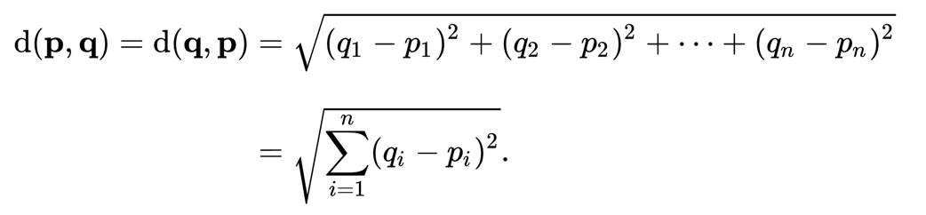
Ecludian Distance

Slide 4
Langkah Umum kNN
Tentukan k (jumlah tetangga dekat yang dijadikan pembanding)
Hitung jarak data yang mau diprediksi ke seluruh data observed
Urutkan hasil perhitungan jarak secara ascending
Ambil data sejumlah k lalu ambil mayoritas kelas data

Slide 5
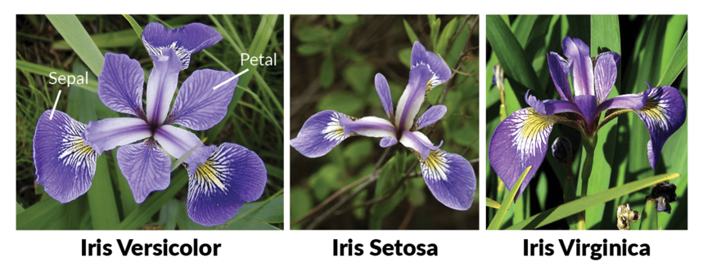
Source: DataCamp

Slide 6
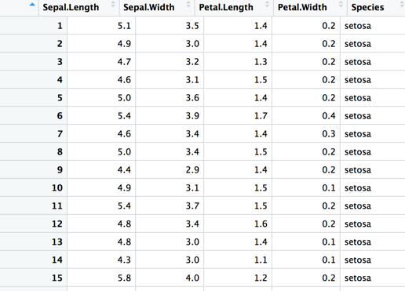

Slide 7
Decision Tree

Slide 9
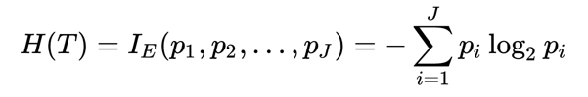
Information Gain

Slide 10
Langkah Umum Decision Tree
Select the attribute with the highest information gain
Let p_{i} be the probability that an arbitrary tuple in D belongs to class C_{i}, estimated by |C_{i, D}|/|D|
Expected information (entropy) needed to classify a tuple in D:
Information needed (after using A to split D into v partitions) to classify D:
Information gained by branching on attribute A

Slide 12
Class P: buys_computer = “yes”
Class N: buys_computer = “no”
means “age <=30” has 5 out of 14 samples, with 2 yes’es and 3 no’s. Hence
Similarly,

Slide 13
age?
<=30
overcast
>40
31..40
student?
yes
credit rating?
no
yes
excellent
fair
no
yes
no
yes

